Slide 1

Standardized Program Evaluation protocol (SPEP™): A Brief Introduction

Slide 2
Research
Sustainable continuous performance improvement process for juvenile justice intervention services with the intent on recidivism reduction
Dr. Mark W. Lipsey, one of the most world’s foremost scholars in program evaluation, research synthesis, juvenile delinquency intervention and field research methodology developed the SPEP™ evidence-based scoring model in the early 2000’s
Utilizes a meta-analytic data base of over 700 experimental and quasi experimental studies of interventions with justice involved youth
Focuses on intervention services’ ability to reduce delinquency and covers studies between 1950 – 2014 (currently)
Worked with North Carolina and Arizona Juvenile Justice Systems to validate his model
Dr. Gabrielle Lynn Chapman joined Mark in 2008 as SPEP™ moved into its 3rd U.S. state and created the performance improvement process and training materials that complement and build off of Dr. Lipsey’s SPEP™ model

Slide 3
Lipsey’s research and meta-analysis support four key findings:

Slide 4
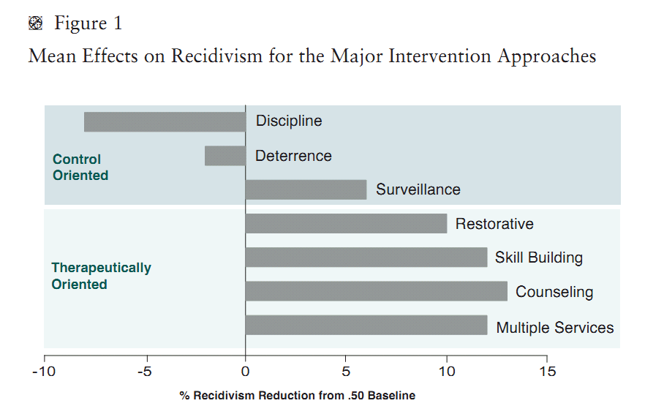
Key Finding #1: Intervention Philosophy Matters
Howell, J.C., & Lipsey, M. W. (2012) Research-based guidelines for juvenile justice programs. Justice Research and Policy, (14) 1, p.1-18.

Slide 5
Key Finding #2: Comparable Impact
Home grown or generic intervention services make up the majority of available services for justice involved youth
Research evidence indicates that home grown services can be as effective as brand name services in terms of recidivism reduction if they are delivered well and with fidelity
A serious disadvantage of homegrown/generic services is that they often do not have fidelity guidelines. Commonly, these interventions...
  “lack the specificity that comes with the protocol for a model program and the associated training and support systems that are also often available from the developer” (p. 3).
Howell, J.C., & Lipsey, M. W. (2012) Research-based guidelines for juvenile justice programs. Justice Research and Policy, (14) 1, p.1-18.
Notes:
NOTE - SPEP inserts evidence based practices into locally developed programs

Slide 6
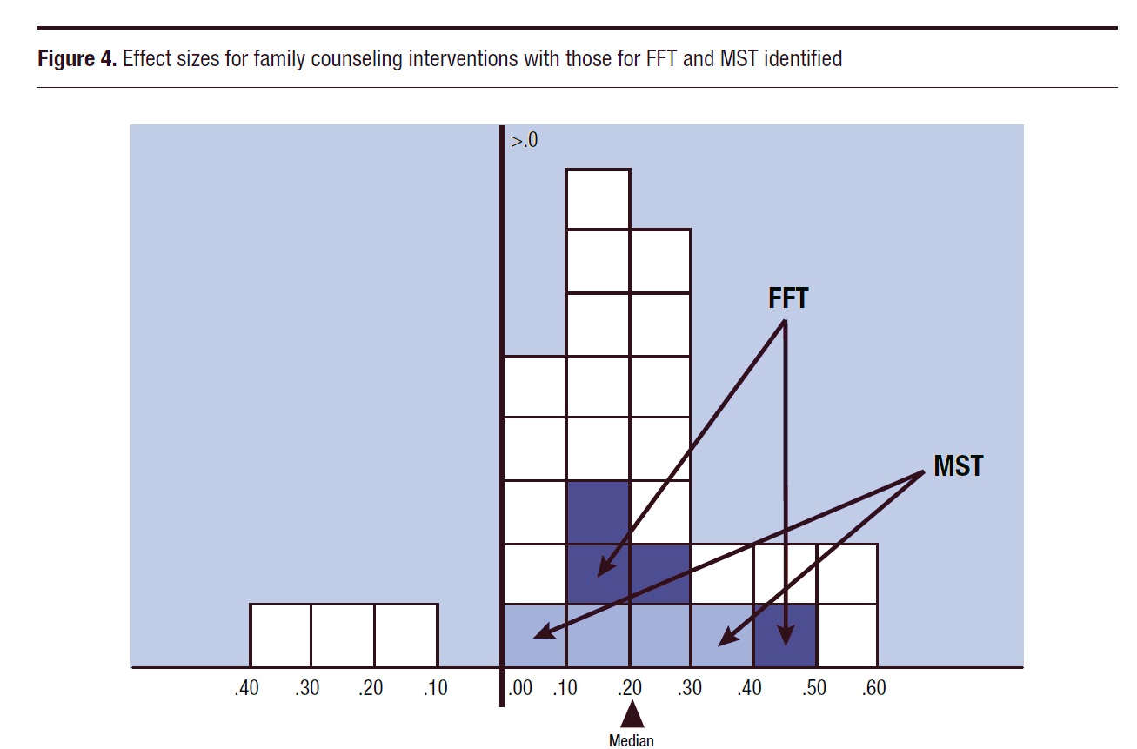
Family Counseling Example
Harmful
Impact
Positive
Impact
21 “homegrown”
4 MST
4 FFT
29 Total
Lipsey, M. W., Howell, J. C., Kelly, M. R., Chapman, G., & Carver, D. (2010) Improving the Effectiveness of Juvenile Justice Programs: A New Perspective on Evidence-Based Practice. Georgetown University, Washington, D.C., USA.

Slide 7
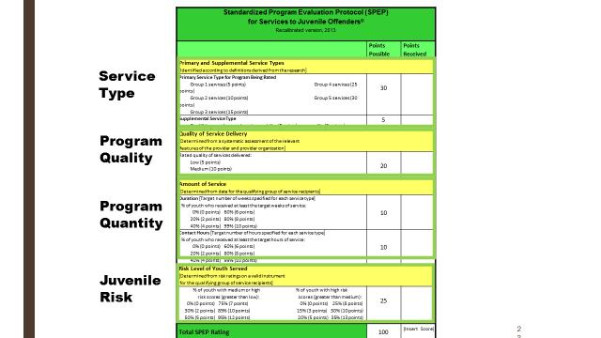
There are four factors most strongly related to recidivism reduction in intervention services for justice involved youth
Key Finding #3: Key Components
Service Type
Quality
Dose (Quantity)
Risk
*Strongest predictor of recidivism identified in the meta-analysis.
Lipsey, M. W. (2009). The primary factors that characterize effective interventions with juvenile offenders: A meta-analytic overview. Victims and Offenders (4), 124-147.
Notes:
Focus on these today . . . The nuts and bolts

Slide 8
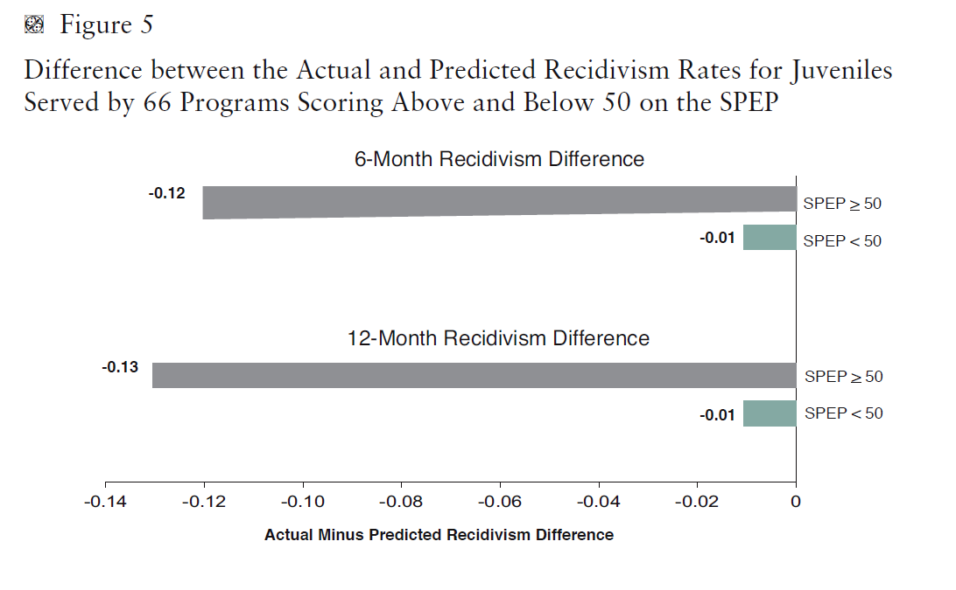
Key Finding #4: SPEP™ Ratings Are Predictive
*Quality of service delivery not scored in this sample.
Howell, J.C., & Lipsey, M. W. (2012) Research-based guidelines for juvenile justice programs. Justice Research and Policy, (14) 1, p.1-18.

Slide 9

The SPEP™ process
Uses research-based evidence to drive changes needed for reform
Not a one and done tool
Continuous performance improvement process for both home grown and brand name services/programs
Leverages what is currently working to support and strengthen existing best practice
Designed to be used by government entities in partnership with private & nonprofit providers
All while building and/or reinforcing a climate of:
          Partnership
          Education
          Transparency
Notes:
3 practice pillars, separates the model from an audit; SPEP culture is part of the tool/Process adoption

Slide 10
What SPEP™ is not . . .
Not designed for non-delinquent populations
Not designed to be an “audit” tool or “gotcha” game
The purpose of SPEP™ rating/scoring is to inform performance improvement NOT to grade a provider, program manager or facility
Providers/Program Managers are NOT scored – services (in specific locations) are rated in comparison to research evidence
SPEP™ is NOT an effort to make all services brand name – it is focused on change & optimization from within – work with what you have in place

Slide 11

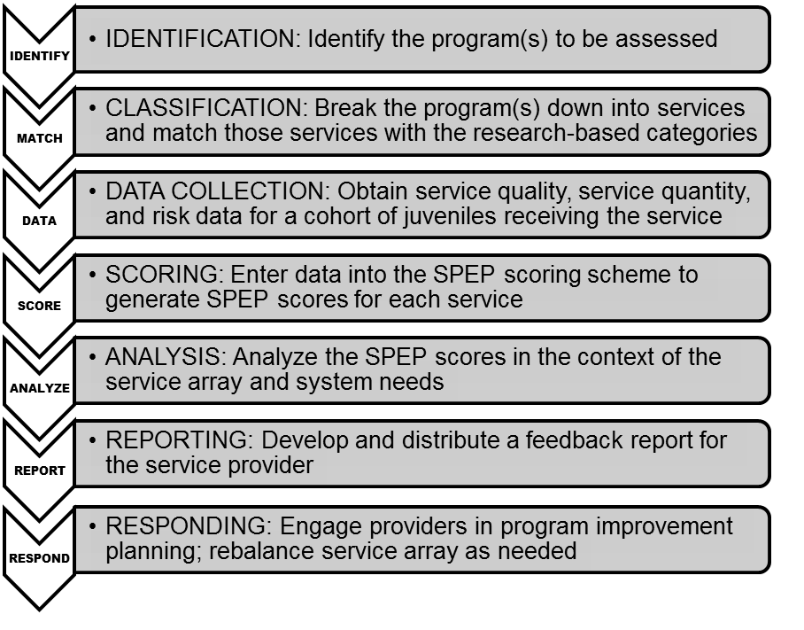

The SPEP™ life cycle
The process kicks off with a classification interview
Notes:
The center stone of this Process is the SPEP life Cycle
Run through each step in the life cycle. . .
Each of the steps are part of the overall SPEP process for performance improvement – and they each have a diagnostic function of their own – especially relevant in the implementation phase
I - What are the kids actually getting
M - Match this to research evidence on that service
D - Data for that service and a cohort of kids receiving it – quality of the service, how much, risk level of kids receiving it
S - Scoring/rating in comparison to research evidence of JJ intervention services
A - Understand context; e.g., 5 social skills program example & 3 group counseling sessions a week, each with different topic/focus
R - Report out – transparently/educate about intent
R - Response/improvement is a group effort; e.g., assessment center delays
Then starts again . . . But with a faster, smoother identification and classification bc if did your due diligence on front end, check list to work from/confirm services etc.

Slide 12

Thank you!
Questions & comments?
Contact information: gabrielle.chapman@vanderbilt.edu
Mark.Lipsey@Vanderbilt.edu

