Slide 1
Implementation Science 101: Scaling Up and Sustaining Evidence-based Programs
Hosted by the EPIS Implementation Specialist Team
Thursday, April 7, 2022
9:00-11:00am
Notes:
HR

Slide 2
WELCOME!
All participants in today's webinar will receive a Certificate of Attendance.
The webinar is being recorded.
We will be taking a five-minute stretch break at 10am!
We will try our best to answer questions at the end that are submitted to the hosts in the chat.
Let's meet today's hosts!
Notes:
HR
*if you are sitting in a room with a number of individuals, type in the chat who all is with you so we can ensure each will get a certificate

Slide 3
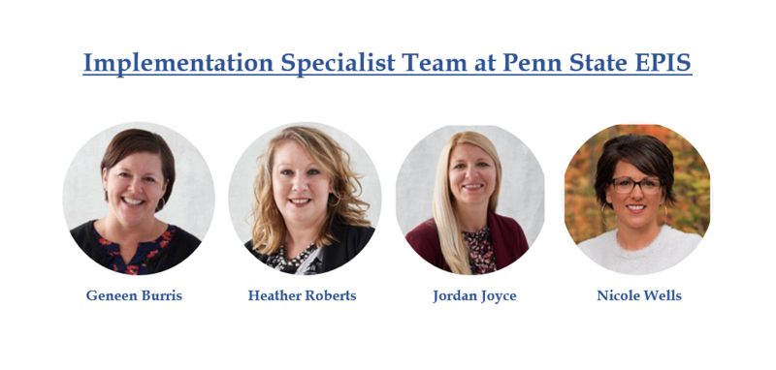
Notes:
HR
Have 1 person introduce all

Slide 4

After today's webinar, you will be better prepared to...
Select evidence-based programs that target the needs of your school and community.
Navigate starting up a new program.
Understand best practices around monitoring and evaluating your program.
Form partnerships throughout your community to help support and sustain programming.
Notes:
HR

Slide 5

Notes:
GB
Poll – Rate yourself on your understanding of Implementation Science.
When it comes to the implementation science of evidence-based programming, my level of understanding is...
4 – I'm a rockstar and could host this webinar 3 – I know stuff but I don't know stuff 2 – I know very little 1 – I don't know what day of the week it is

Slide 6
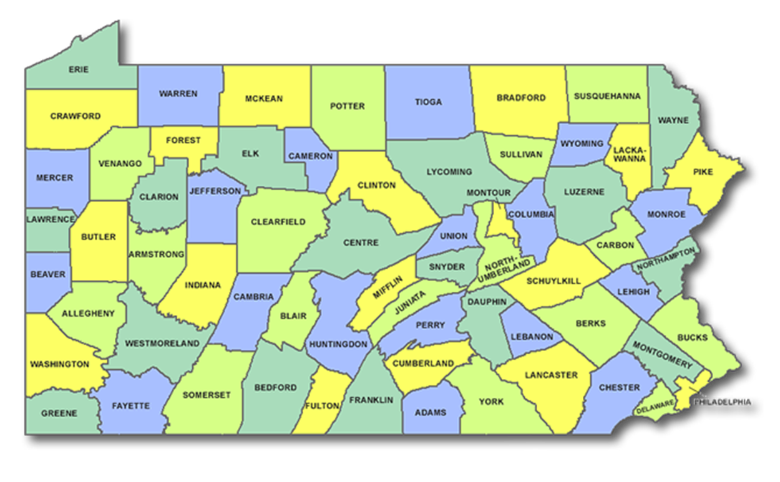
What is Implementation Science?
Implementing strategies based in science to ensure you will achieve the best possible outcomes for the children, youth and families that you serve.
Notes:
NW
Let's start by defining what we mean when we say Implementation Science -
It is a pretty simple definition – but it's so powerful and transformational as Implementation science connects the science (AKA the evidence, data, outcomes, etc that we collect) and actual real-world practice (how are we facilitating our programs and how are we engaging with youth, caregivers and community members) to get the best possible outcomes.
Imple­men­ta­tion sci­ence strives to under­stand the fac­tors and con­di­tions that ensure effec­tive prac­tices are suc­cess­ful­ly car­ried out and, more importantly, that they are sus­tained. It's a field that helps us identify the changes that can be made within systems of organizations so that the evidence-based strategies and programs that are being implemented can be effective.
It really is the bridge between what the science tells us the needs are and what has been proven as an effective intervention or prevention strategies to address it. in other words, Implementation Science helps improve the likelihood that youth and families being served can reach their fullest potential.

Slide 7

The EPIS Implementation Specialist Team supports the following components of Implementation Science:
Program Selection
Program Readiness
Funding
Program Implementation
Monitoring Impact and Outcomes
Collaboration with Key Stakeholders
Notes:
NW
The Implementation Specialist team here at Penn State EPIS supports these components of Implementation Science.
These are the essentials on the road to success and there is evidence that making data-driven decisions from the initial thought of program selection and readiness all the way through program delivery and sustainability yields greater outcomes.

Slide 8

Program Selection
Notes:
JJ
Program Selection is the first component of Implementation Science that we will be taking a deeper look at today. This pre-implementation stage can be a lengthy process as it involves many people, many key players or stakeholders from across your community and it involves a lot of data or information gathering. Because, before selecting a new program, it is incredibly important to better understand what is happening across your community in order to know what is needed and which programs would be the right fit.
This whole process, ideally, would involve a Needs Assessment where more of a collaboration of community members-agencies-and schools are gathering community-level data to know what is going well and what areas need attention. There may be many programs being implemented already throughout your community so that is a key piece of knowledge that shouldn't be overlooked –

Slide 9
Program Selection
What does your community need?
What is currently in place?
Where are the gaps?
What options do we have?
Notes:
JJ
In summary, Program Selection includes finding out what does your community need, what is currently in place, where are the gaps, and what options do we have?

Slide 10
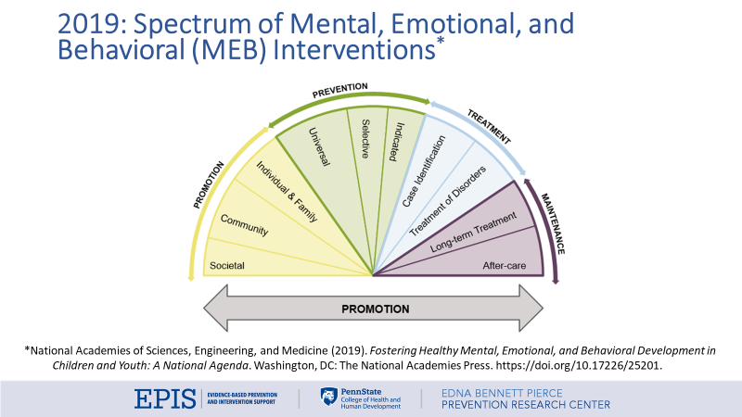
Notes:
JJ
We wanted to be sure to share this Spectrum of Mental, Emotional and Behavioral Interventions graphic with you today to help think more about the continuum of prevention and intervention across your own communities. This continuum of care was created with the idea to that to truly improve the overall health of our community (the mental, emotional, and behavioral health), we need to be providing more of a comprehensive set of services/programs. You see here that the segments range from promotion through prevention, treatment, and maintenance.
So as you are conducting that Needs Assessment in your communities, and figuring out what is already being implemented, you can use this continuum to categorize services/programs into these segments. Again, where are the gaps – what is missing in your community, if anything.
These services or programs that are being implemented though OR those that you are looking into, SHOULD be evidence-based and accessible to the targeted population. Let's now get into, how do you know if a program is evidence-based....

Slide 11
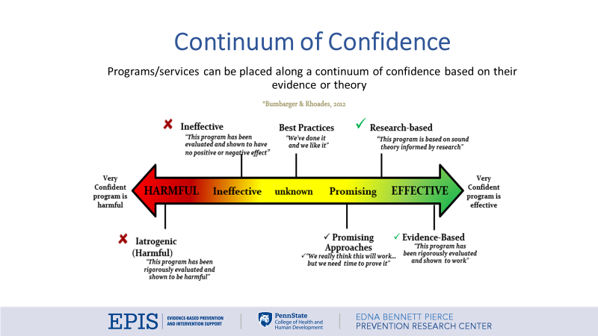
Notes:
JJ
This is our Continuum of Confidence, developed by EPIS researchers back in 2012. We use this as a visual tool in placing programs along this continuum, based on evidence. You see here that if a program is placed on the left-hand side, red part of the continuum, there is evidence that the program actually causes harm. If a program or service is placed on the right side, the green end, then it means that there is strong evidence to support the confidence of it being highly effective. The middle section is more for those programs and services that don't have the evidence to support whether it is effective or harmful.
I'm going to talk more about each of these three sections in the next few slides...

Slide 12
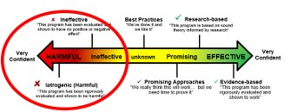

Ineffective approaches rely on emotional appeals; which are focused on danger or deterrence.
Some examples of ineffective approaches:
Horror stories
Dramatization of dangerous/harmful effects
Gruesome photos or videos
Tours of jails; boot camps
Utilization of infrequent or one-time presentations
Research on these approaches consistently shows their inability to prevent substance use. Youth exposed to these approaches have been shown to be MORE likely to use substances. No scientific debate on these because there is no evidence of effectiveness AND there is evidence of harm.
Notes:
JJ
Let's start with what programs look like that are harmful and placed in the red. These are approaches that consistently show their inability to prevent targeted positive outcomes. They tend to rely on more emotional appeal and focus on danger or deterrence. We have some examples listed on this slide – such as tours of jails, one-time presentations that focus on the dramatization of horror stories or gruesome photos and videos. Obviously, we want to learn which programs DO fall on the red end of the continuum and stop them from occurring again and avoid them in general.

Slide 13
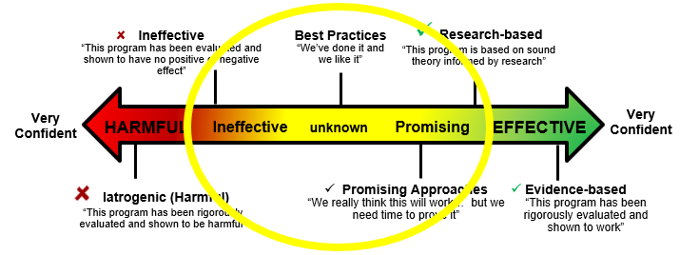
Those programs that fall into the middle of the continuum either have not been evaluated OR it has been evaluated and there are no effects.
Notes:
JJ
And as I mentioned already – the services that would be placed in the yellow mean that they have either NOT been evaluated yet OR there has been an evaluation conducted, and there are no effects whatsoever.

Slide 14
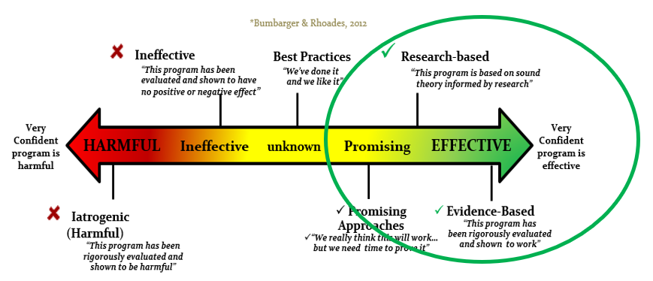
Programs on this side of the continuum...
Improve Knowledge + Beliefs/Attitudes + Skills
Are Strengths-based approaches
Include transfer of skills to Individual, peers, family, school, community
Are interactive, and hands-on
Include enough time (weeks/hours) to have impact (dosage)
Notes:
JJ
Now let's talk more about the programs that would fall on that right side, the effective programs. These programs or services (read bulleted items)…
This is a nice visual though to use as you are presenting about programs currently being offered in your community now OR as you are considering what programs to bring into your community.
I'm sure you are all wondering – how do you figure out where the programs fall? Well, you have the ability to read through the research yourself, but we all have access to Clearinghouses that have done all of that work for you already and summarize findings....

Slide 15
PROGRAM CLEARINGHOUSES
Rating Source​ | Area of Focus​ | Website​
Results First Clearinghouse Database | Combines 9 national clearinghouses | https://www.pewtrusts.org/en/research-and-analysis/data-visualizations/2015/results-first-clearinghouse-database
Blueprints for Healthy Youth Development​ | Child welfare, juvenile justice​ | www.blueprintsprograms.com​
California Evidence-Based Clearinghouse for Child Welfare​ | Child welfare​ | www.cebc4cw.org/​
CrimeSolutions.gov​ | Criminal justice​ | www.crimesolutions.gov/​
What Works Clearinghouse ​ | Education​ | ies.ed.gov/ncee/wwc/​
What Works in Reentry Clearinghouse​ | Criminal justice​ | whatworks.csgjusticecenter.org​
​Title IV-E Prevention Services Clearinghouse (Family First)​ | ​Child welfare​ | ​https://preventionservices.abtsites.com/
Notes:
JJ
We are providing you with a table that includes seven different clearinghouses. The name of the clearinghouses is on the left column, the middle column provides you with the area of focus that the programs listed on their clearinghouse support – such as the child welfare system, the column on the right gives you the link on how to access each of those clearinghouses to look up programs.
As you visit any of these clearinghouses though, you can easily see their ratings and why, what the outcomes are of the program, how to implement the model with fidelity in relation to who delivers the program-how long does the program last, how many sessions are there, who is the program delivered to, what is training in the model like, etc.. These details are imperative in being able to narrow down program options for your community and we have come to rely on them for quite some time now as they are incredibly valuable.

Slide 16

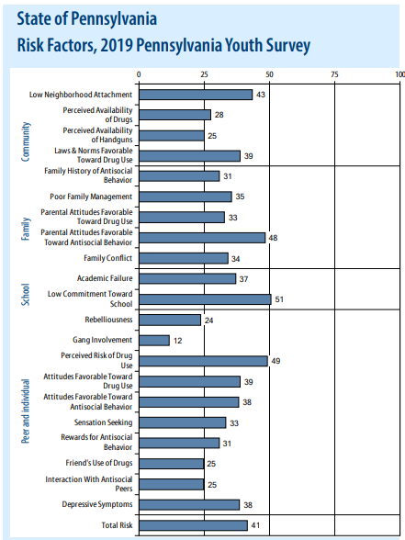
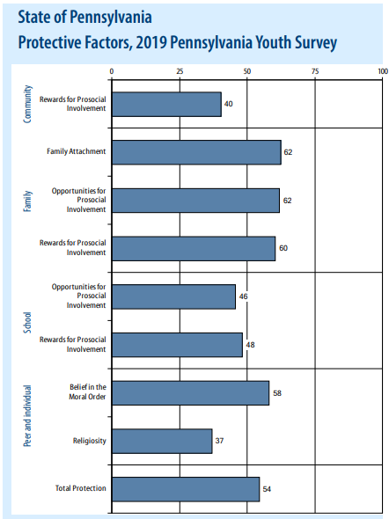
Notes:
JJ
I had mentioned already about how during Program Selection, you would be going through a Needs Assessment process to fully understand your community needs, what is already present and what is needed.. We have conducted these same processes at PCCD and EPIS. We utilize the statewide PAYS Surveys to monitor the data over time, better understand the data that is being reported by youth across Pennsylvania. We closely look at those higher risk factors and lower protective factors while choosing appropriate programs that address them. Overtime, we have made those program selections and they now make up our EPIS menu of programs.
I have one more resource that I would like to share with you before we move onto the next component of Implementation Science...

Slide 17
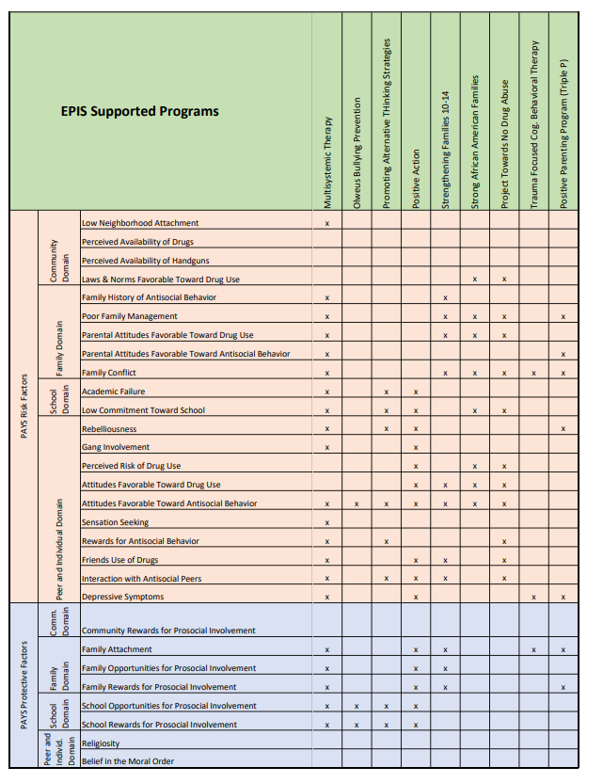
Mapping EPIS-supported programs to Risk and Protective Factors
Notes:
JJ
This is our two page resource that shows our Menu of Programs in green and then there is a crosswalk of which risk and protective factors each program addresses.
This document may be very helpful to you as a quick guide, to atleast the programs that we have a strong knowledge base of at EPIS and many resources to support them... Let's say, you are looking at your own school's PAYS data overtime and your coalition has found that the risk factor of Family Conflict needs to be addressed. There are several programs on the front and backside of this document that address that risk factor with the X's across that row.

Slide 18
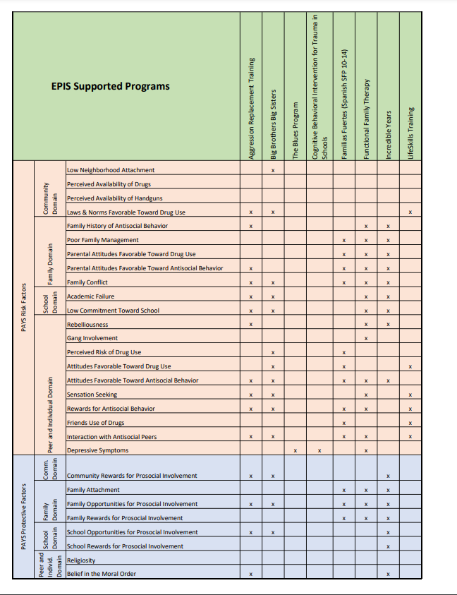
Mapping EPIS-supported programs to Risk and Protective Factors
Notes:
JJ
I'm going to pass things off now to Geneen to move us onto Program Readiness

Slide 19

Program Readiness
Notes:
GB
Program readiness is just as it sounds...are you and your agency or school ready to bring an evidence-based program to your community? While it might feel like it's as easy as saying "yes we are!"...have you really dug into and answered questions around program readiness? What are these questions? Let's take a look...

Slide 20
Questions when considering programming...
Are the risk and protective factors, addressed by the chosen program, identified and/or prioritized by your very own community?
Who can deliver the model?
Where can the program be delivered?
How many participants can you engage in the program? Is the program implemented with a group or individually?
Is the program appropriate for the population you plan to target?
What are the outcomes you intend to change in your targeted population?
Do you have buy-in from staff of all levels from Directors to Administrative Support Staff, your community stakeholders and key leaders?
Do you have access to funding and necessary resources to start up and sustain key implementation elements of the program? Making sure to carefully consider and designate those responsible for sustainability planning and securing funds/resources right from the start?
Determining data collection needs…Who will be responsible for distributing and collecting the surveys? Who will be responsible for data entry? Who will be responsible for analyzing and reporting the data results?
Can all of these expectations for quality and dosage be met within the existing structure and with the existing resources?
Notes:
GB
Don’t read all-just highlight a few
This list isn't comprehensive...there are many more questions to consider, especially around a specific program you plan to implement. You have the best chance of implementing a successful program for your community if you take the time to be completely READY for all the things.
Now I'm going to turn it over to Nicole, who will discuss funding.

Slide 21

Funding
Notes:
NW
Let's take a moment to talk about funding. Many organizations can't expand their service lines or offer new programs due to the costs associated with start up and training- so it's important to think about funding in a sustainable, systematic way.
When considering program – know what costs are involved in delivery of the program to ensure it's delivered with fidelity, and you are able to sustain your efforts...
know the cost of implementation – what do you need to start implementation your EBP? Things like:
Office or meeting space
Printed materials or handouts – many providers accured mailing costs during the pandemic because they were mailing kits and manuals to participants.
A website or social media platform
Equipment (dry erase boards, flip charts, facilitator manuals computers, etc)
Staff
Training or consultation
Incentives for participants or volunteers
Second – once you’ve launched your EBP – what’s it going to take to stay operational? Take into consideration replenishing supplies, hiring and training new staff members as the program expands, employee benefits or employer taxes, travel reimbursements to staff delivering the model at various locations, and meeting spaces.
Also think about Cost efficiency – when we think about working smarter not harder we think about how to stretch our dollars and more efficiently use our funding.
Consider things like the location in which you’re delivering your EBP – is the cost of renting the space reasonable, are you or your staff traveling far to get there, does the location allow for program expansion over time or is the entity who is offering you space willing to contribute on an in-kind basis either volunteers or space to help with overhead costs

Slide 22
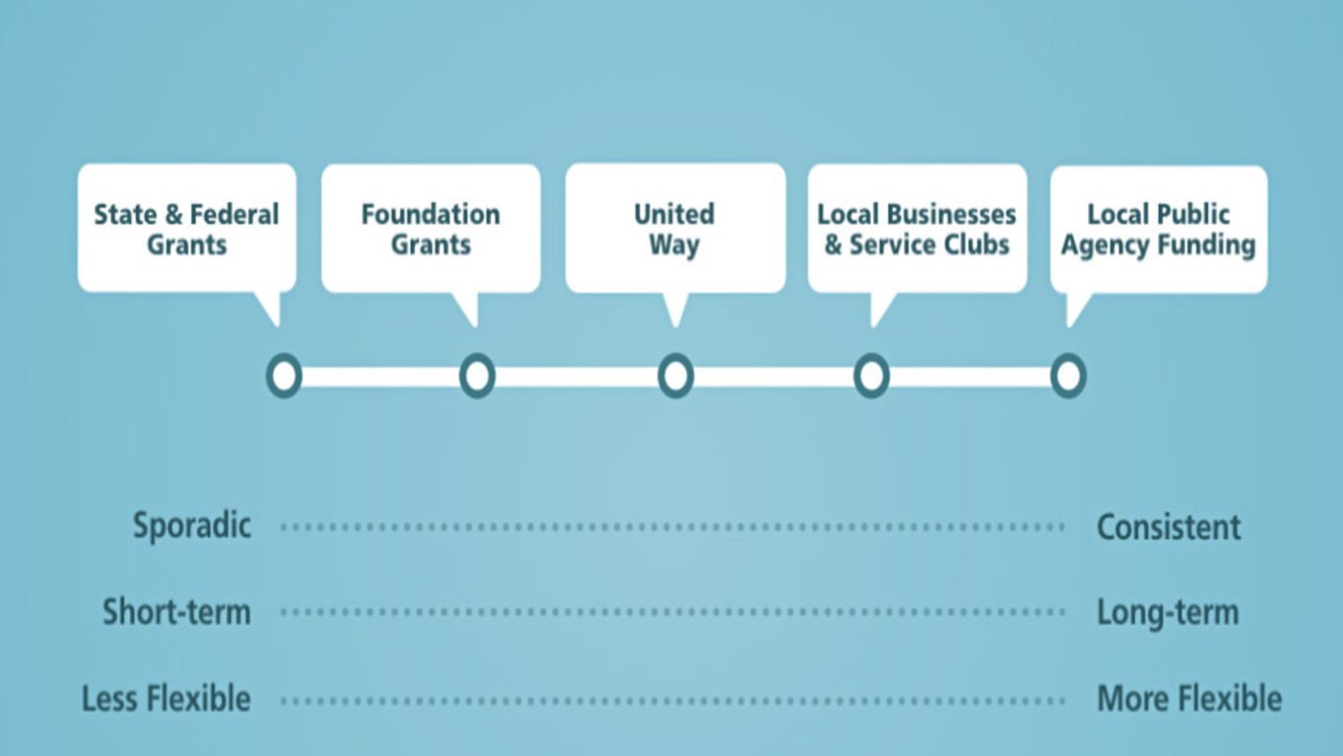
Notes:
NW
When you start to think about some sources that can be used to sustain your EBP we start to thinking about two things - High priority, long-term funding sources and low priority, short term funding sources.
Examples of long term sources are things like the county needs based budget, school district dollars or medical assistance reimbursements
When we talk about short terms funding sources, these are the dollars that don’t last forever. Typically grants that are used as seed money to help cover the start up costs of a program, but that you know have a shelf life. Some grants to think about are those offered by:
The federal government like SAMHSA, HRSA
State grants such as the PCCD funding that many of you have or had
County funding such as block grants, Children and Youth or mental health dollars
Some communities have various Foundations that can make donations or offer grant opportunities
But there’s also the United Way or grants from larger corporations like manufacturers or hospitals
Tips for success in pursuing funders:
Go for No – be confident when approaching potential funders and don't accept no for an aswer
Build relationships (start early, this takes time) - relationships and partnerships are really important to success so don't neglect time to build relationships with key internal and external stakeholders
Diversify Funding – not all money needs to come from a single source
Pursue Grants that fit your mission (don't rely on them exclusively!)
Develop a committee for sustainability – intentionally discuss sustainability on a on-going basis
Ask individuals/businesses/etc - funding can come from anyone, any where so think about indiviudals and businesses who may have a vested intersted in supporting your mission and programming
Seek In Kind Contributions – who doesn't like it when someone is willing to work or contribute for FREE
Program Sponsorship
Collaborate/share resources

Slide 23
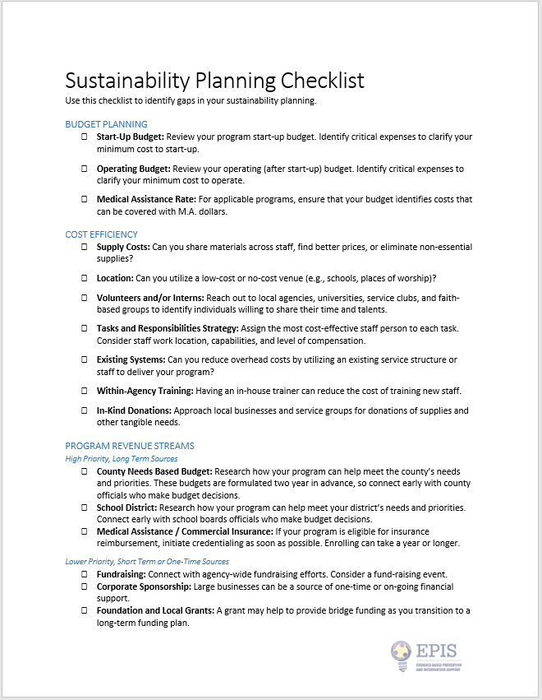
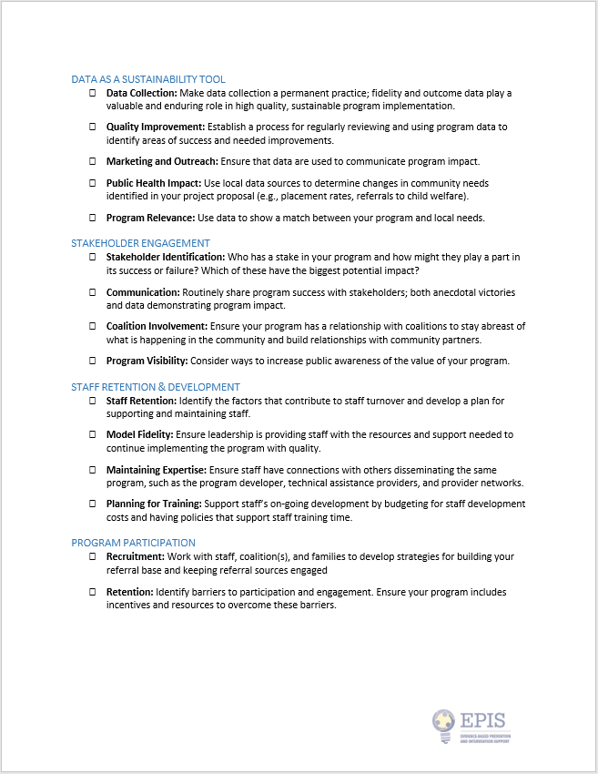
Check out our Sustainability Planning Checklist to navigate funding strategies and cost-effective approaches for program delivery:
https://epis.psu.edu/node/935
Notes:
NW
On our EPIS webiste you'll find our sustainability planning checklist which has suggestion on how to navigate and strategize cost effective approaches to program delivery

Slide 24

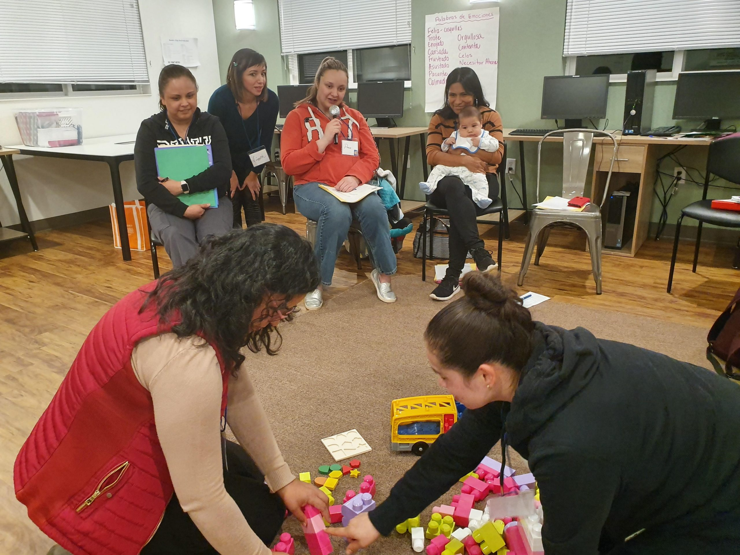
Program Implementation
Notes:
HR-Thank Nicole.....So now we are going to talk about Program Implementation.

Slide 25
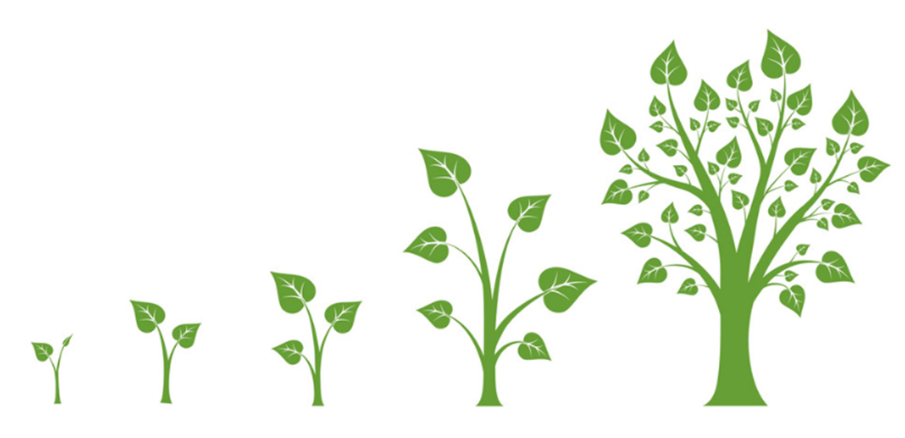
Model Fidelity
Evidence-based programs are proven to get high quality outcomes for children, youth, families, and communities. However, these programs only predictably produce quality outcomes when they are implemented as they were designed by the researchers who developed them, with fidelity to the model.
Notes:
HR-An important part of program implementation is model fidelity. (Read slide)

Slide 26



Manualization of Evidence-Based Programs
Notes:
HR
Many Evidence-based programs are manualized, and all have mechanisms for clearly defining the core components that must be delivered to ensure outcomes.
Many provide scripts for those that deliver the program, agendas to follow for sessions, and everything is so detailed because they are meant to be followed and not changed. These manuals and required core components are what was delivered when program’s research was being conducted. So if you change a curriculum or core component to make it your own, you aren’t delivering that evidence-based program, and then you may not see the positive outcomes that the actual program is researched and proven to have.

Slide 27
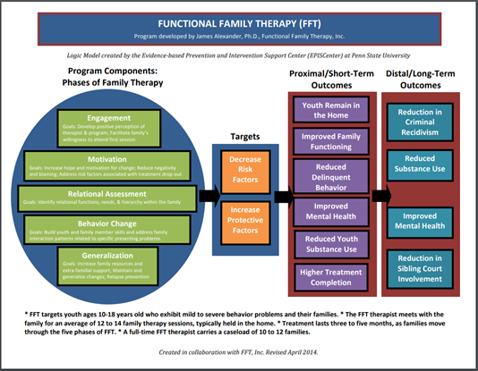
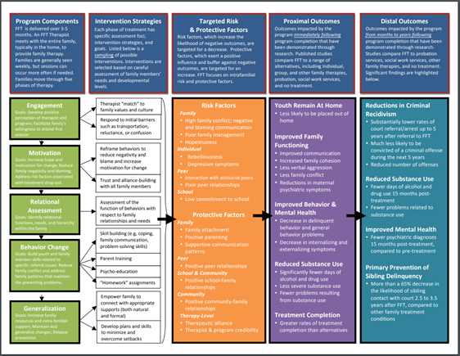
Logic Models
Notes:
HR-Here is an example of a logic model that EPIS created by working closely with the program developer. EPIS tries to use a similar look and feel when creating logic models, however some programs may have logic models that look slightly different.
Here we have an example for Functional Family Therapy or FFT. Page 1 or the page to the left of the screen shows a more general visual for how to understand the flow of the program-so the program components and the expected short and long term outcomes.
Page 2 shows the much more detailed, program-specific implementation information. So you see the program components on the left-hand side in green, broken down. You see how those program components include specific intervention strategies in white. When the model is implemented with fidelity, you will see a decrease in the risk factors for your community and an increase in protective factors-which are in the orange box. Again, leading to the short-term outcomes in purple and the long-term outcomes in teal. We often refer to this as the "recipe" for the program.

Slide 28
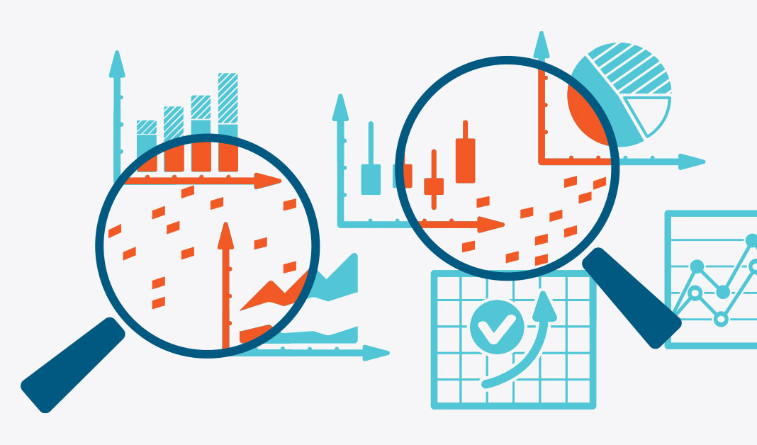
Model Fidelity further defined...
Adherence
Duration
Dosage
Quality of Delivery
Participant Engagement
Notes:
HR
Monitoring fidelity is an integral part of promoting model adherence, quality implementation, sustainability, and demonstrating program outcomes and impact.
Adherence (did the facilitator/practitioners deliver at least 75% of the core components and content as designed by the developer of the program?)
Duration (were the lesson/sessions delivered with the correct amount of frequency, and for the recommended amount of time, to ensure all components and content can be covered- without extending services beyond what is required?)
Dosage (did the participants receive enough of the program to ensure the best chance of a positive outcome?)
Quality of Delivery (did the facilitator/practitioner deliver lessons or core components skillfully, using the recommended approach, energy level, and engagement strategies?)
Participant Engagement (were the program participants engaged in the lesson or sessions)

Slide 29

Program Implementation – COVID Adaptations
Program Sign Ups through QR Codes – Online Questionnaires.
Offering programs virtually or utilizing a hybrid model.
Decreasing number of program participants.
Developing policies around checking in with program participants before meeting to ensure everyone is healthy, not exhibiting COVID symptoms.
Pre- and Post-Surveying by utilizing an online platform.
Offering handouts and curriculum virtually.
Cost savings to not paying for childcare.
Time efficiency/flexibility with offering programming virtually.
Notes:
HR
(Read slide)
Mention that some sites mailed program materials/ kits to participants to increase virtual engagement/ participation.
More frequent Learning Community meetings to share how others were address barriers and creative ways to overcome challenges.

Slide 30
Program Implementation – COVID Challenges
Schools may not be able to allow external program providers in their buildings.
Schools may still have the need to be virtual every now and then, causing inconsistent programming.
Families may not have reliable internet.
It is quite difficult to navigate collecting evaluation data online.
Some folks are not comfortable yet having people enter their homes.
Some folks are not comfortable yet participating in a group program.
Staff turnover.
Notes:
HR-(Read slide)
Privacy for virtual sessions when participant are in their homes is limited.
Difficult to create a safe space for sharing because participants don't know who's listening on virtual sessions.
Choosing a HIPAA compliant platform to conduct group sessions was difficult.

Slide 31
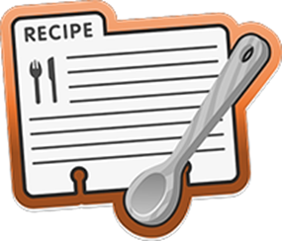
Notes:
HR-I mentioned earlier that we often refer to the logic model as the "recipe" for a program. So I have this analogy that I want to share with you. So think about a recipe for baking or cooking something. We know that recipes include different ingredients in different amounts or measurements.

Slide 32

Notes:
HR-When we follow the recipe and add all ingredients and measurements exactly as directed, we get the end result that we are expecting. So in this example the spongebob cake.

Slide 33

Notes:
HR-If we don't follow the recipe-maybe we don't have the ingredients that the recipe calls for so we decide to use alternative ingredients or we add too much or too little of some of the ingredients.

Slide 34
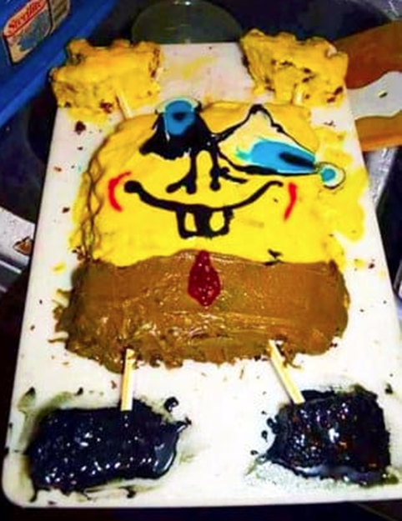
Notes:
HR-We may end up with a cake that doesn't look like a cake, doesn't taste like a cake, or isn't even close to what we were hoping for or expecting. Same thing with evidence-based programs. In order to achieve the expected outcomes, we need to remain mindful of the recipe-or fidelity to the model!
So.....YES, adaptations for your community or those who are part of your program will occur.. But....working with the program developer or consultant to discuss any adaptations is important. The key is to balance fidelity and adaptation!

Slide 35
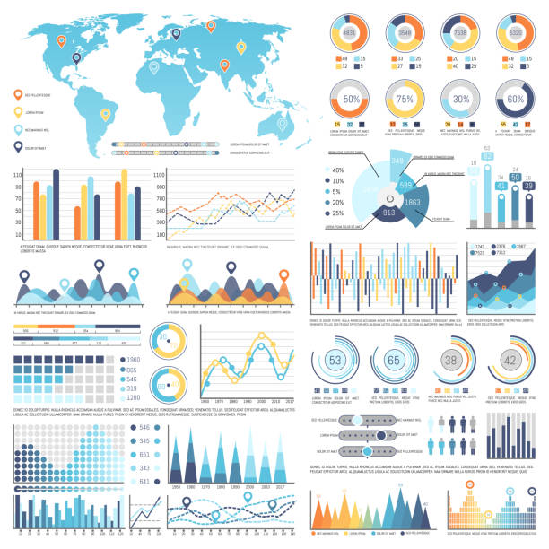
Monitoring Impact & Outcomes
Notes:
JJ
Monitoring Impact and Outcomes. Now why is this so important? Well, rhis is exactly how you KNOW the programs or services that are being implemented, ARE in fact having a positive impact on those that are participating in them. That you are collecting your data and understanding it - both short and long-term data reviews will inform your future decisions. Data collection, information gathering, monitoring impact and outcomes of evidence-based programming is absolutely essential!

Slide 36
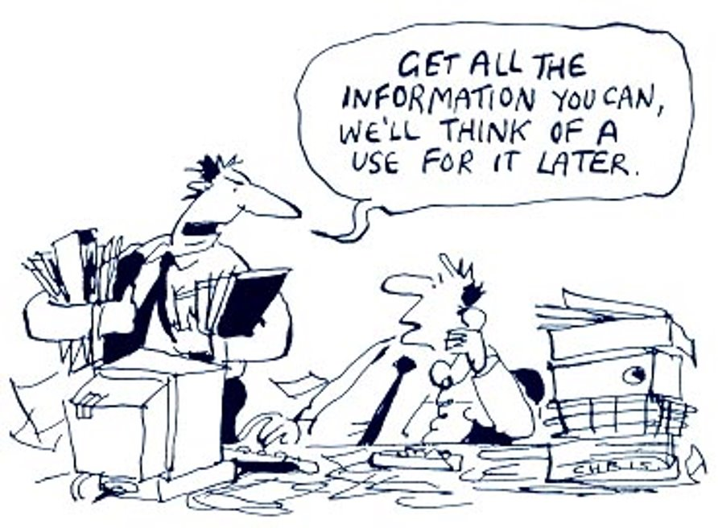
Notes:
JJ
Let's take a look at this comic. There are two gentlemen, flooded in paperwork and the one gentleman says to the other, 'Get all the information you can, we'll think of a use for it later.' It seems quite chaotic doesn't it?? And clearly, there is no purpose to all of the information and paperwork that they are gathering. This is NOT what we want to encourage at all. There should be a purpose to the data and information you are collecting for your programming.

Slide 37
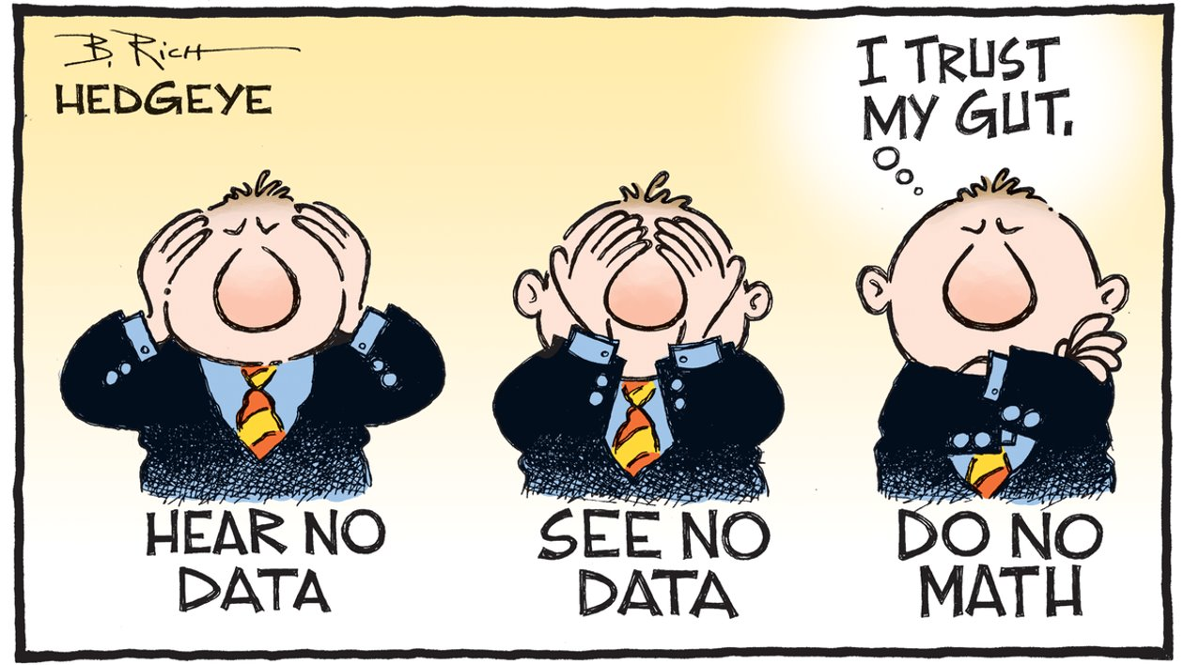
Notes:
JJ
I have another comic to share. This person is saying.. Hear No data, see no data, do no math.. This person wants to trust their gut.
This too is NOT what we want. We strive to support communities, agencies and schools in making data-driven decisions along with their strategic planning. There's certainly a balance between the two comics.

Slide 38

Find the balance of collecting the right amount of data and information that is useful and meaningful!
Notes:
JJ
We want to ensure what we are gathering, is useful and meaningful.

Slide 39

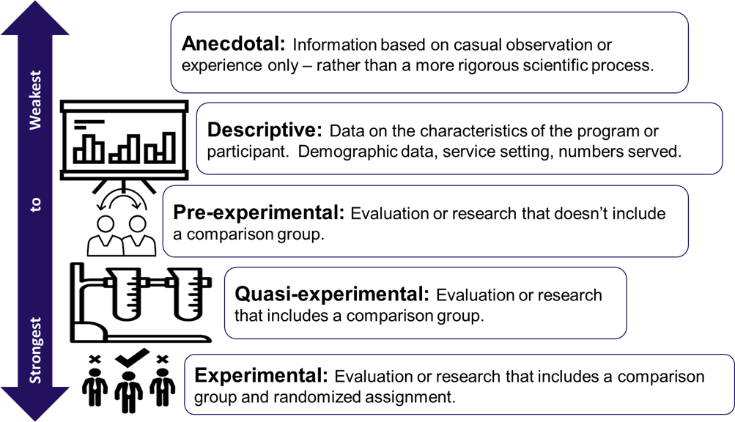

Adapted from the California Clearinghouse of Evidence-Based Clearinghouse for Child Welfare: https://www.cebc4cw.org/files/CEBCTypesOfResearchEvidence.pdf
Notes:
JJ
It's good to know what are the different types of ways to collect data and information for your program. In front of you lists types of evidence that can be conducted from the weakest to the strongest forms. Let's start at the top, anecdotal evidence....
You may be using one of these types or a combination of them. But they are all important within the implementation science world when we are looking into what evidence is out there to support the outcomes that we are trying to achieve. PLUS, what do we want to collect at the community or school level to know what we are doing - is meeting our own targeted goals.

Slide 40
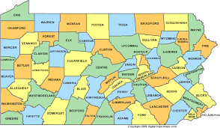
Impact & Outcomes Measurement includes both:
Process Measures
assess a program’s reach and implementation quality
Outcome Measures
assess the impact of the program on its participants.
Notes:
JJ
We aren't going to get into the data collection processes that are in place for each of the programs on our menu today... but we wanted to highlight that we have built standardized data collection resources for the programs on our menu and we strive to be able to better assess both process measures and outcomes measures when it comes to program implementation. Process measures help to understand your program's reach and the quality of your program delivery. Outcome Measures help to understand the impact of the program for those that participated in it.
Knowing these pieces of information, taking pause to understand these data points, will inform you on funding and other key decisions for programming.

Slide 41

Three primary reasons why Data collection is important:
1. It provides you with the evidence to demonstrate to your referral sources that your program works, increasing the buyin and referrals to your program.
2. It provides you with the evidence to prove to current and future funders that your organization is implementing the model as it was designed AND that it’s having an impact AND it’s worth funding in your county/community/school.
3. Program implementation staff will know that by maintaining model fidelity, they ARE having a positive impact on the population they are working with.
Notes:
JJ
As you are collecting program data, it should be shared out and here are three primary reasons in doing so and collaborating with internal and external stakeholders... (read slide)
Nicole will now take us through more in relation to key stakeholders.

Slide 42

Collaborate and Engage with Your Key Stakeholders
Notes:
NW
Engaging and collaborating with your stakeholders is important because
They understand a variety of conditions of your community at any given moment
Possess a wealth of diverse information
They offer Multiple outlets to promote your reputation of providing high-quality evidence-based programming
Collaboration and communication helps us Build relationships across different sectors – really enhancing opportunities for having a systemic impact
And lastly – engaging stakeholders can provide you a better understanding of community priorities and the priorities of those stakeholders

Slide 43

Definition of Engagement -
The process of working collaboratively with and through groups of people affiliated by geographic proximity, special interests, or similar situations to address issues affecting the wellbeing of those people.
Notes:
NW
When we talk about engagement we're referring to The process of working collaboratively with and through groups of people affiliated by geographic proximity, special interest, or similar situations to address issues affecting the wellbeing of those people.
And when we expand this concept and talk about Community engagement – it's a way of communicating and working alongside indiviudals – It ensures that community members have access to valued social settings and activities, feel that they are able to contribute meaningfully to those activities, and develop functional capabilities that enable them to participate fully. This is the idea that we work together to hear what the community's needs are rather than assume we know because progamming is much more likely to be successful when it aligns with what the community values and needs.

Slide 44
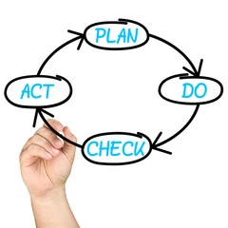
Review process and outcome measures with key stakeholders often
Notes:
NW
When communicating with your stakeholders don't forget to do it often – talk about the process – discuss any challenges or barriers – and share your outcomes and the impact the program is having – but the key here is to do it on a regular basis so folks are always thinking about it, advocating for it and promoting it.

Slide 45
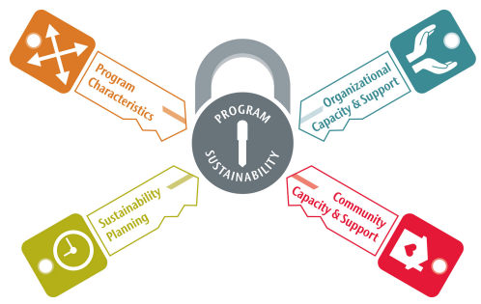
Tying it all together
Cooper, B.R., & Betz, D.L. (2017). How can we keep it going? Key ingredients for evidence-based program sustainability. WSU Publications, retrieved at: https://hdl.handle.net/2376/7305
Notes:
NW
Clearly there are a lot of moving parts and pieces to implementing EBPs
• Be adaptable - Program adaptation includes using empirical and experiential information to adapt the program to fit changing contexts and conditions in order to assure its ongoing success and impact.
• Know what it takes - Organizational capacity includes having the organizational support and resources necessary to successfully manage and implement your program.
• Evaluate what you're doing - Program evaluation includes having the ability to collect, interpret, and use data to assess your program’s impact, and plan and advocate for its future and ongoing success.
• Stay in touch - Communication includes using specific strategies to increase awareness of your program’s needs and to demonstrate its success to key stakeholders and the broader community.

Slide 46

How to get connected...
Join an EPIS Listserv
Follow us on Social Media!
Join into Learning Community Meetings
Direct Consultation (1:1)
Notes:
NW
There's lots of ways to get connected to us – we're here and happy to assist in whatever way we can.

Slide 47



Sign up for the EPIS e-Newsletter here: CLICK HERE!
EPIS Website: epis.psu.edu
Email: EPIS@psu.edu
Geneen Burris: grs119@psu.edu
Heather Roberts: hmr17@psu.edu
Jordan Joyce: jll957@psu.edu
Nicole Wells: npw5251@psu.edu
Notes:
NW

Slide 48
Notes:
GB
Poll – Rate yourself on your understanding of Implementation Science.
When it comes to the implementation science of evidence-based programming, my level of understanding is...
4 – I'm a rockstar and could host this webinar 3 – I know stuff but I don't know stuff 2 – I know very little 1 – I don't know what day of the week it is.

Slide 49
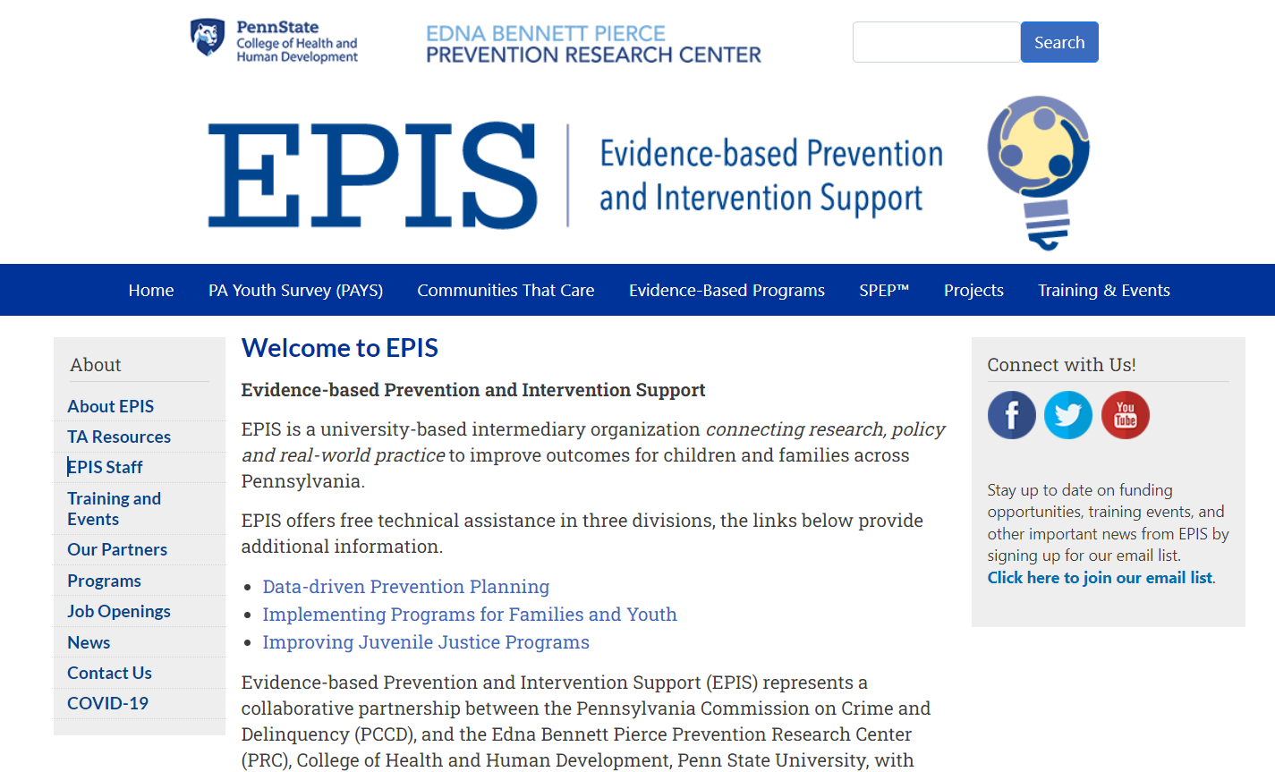
Penn State EPIS https://epis.psu.edu/
Notes:
NW
*If we have a lot of time left, someone can jump into the site and give a tutorial
Walk through of EPIS Site (I was thinking Blues)
Hover over EBP tab and list the various pages that we have, Click on the list of programs, click Blues, Explain the PRogram Home Page, Click on Program Resources and Explain, then Jump to Training & Events to show calendar

Slide 50


Notes:
GB
Thank you so very much for your time and attention on today's webinar. EPIS is a project of the Penn State Prevention Research Center and funded by these state agencies. Again, if you have any further questions for our team after today, please feel free to reach out.
At this time, we would like to open it up to questions from participants...

Slide 51

Notes:
Questions?
*Moderator of Questions: JJ
(each IS will add a question)
Question – Is your team able to meet with us and talk through the various components of programs that aren't on your menu? - Nicole
Question – We are having a difficult time hiring staff lately. Does your team have any suggestions for recruiting staff? - Geneen
Question – We are looking into a curriculum for our middle school students and found one that we like, but it's for high school. Do other school districts deliver programs to other grade levels like this that I just described? - Heather

